Slide 1
ROMANSETU: Efficiently unlocking multilingual capabilities of Large Language Models models via Romanization
Jaavid Aktar Husain, Raj Dabre, Aswanth Kumar, Ratish Puduppully, Anoop Kunchukuttan
Presented by Group 35:
Anusha Pant Nav Sanya Anand Paul Kurian
Sebastian Escalante Shreyas Malewar
Notes:
Nav - 1 and 2, 11 and 12 Shreyas -3 Anusha - 4 and 5 Sebastian - 6 to 10 Paul - 13 to 16

Slide 2
Motivation
LLMs often struggle with non-English languages due to limited training data and lack of resources.
How can we efficiently extend LLMs to handle non-English languages without requiring massive amounts of non-English training data?
Can we leverage existing resources and knowledge to improve LLM performance on diverse languages?
Notes:
Large Language Models are typically trained on massive amounts of text data, but the vast majority of this data is in English. This leads to challenges when using LLMs for tasks involving non-English languages. ROMANSETU proposes leveraging romanization, a technique used for converting text from a non-Latin script to the Roman (Latin) script.

Slide 3
Problem Description
Processing and understanding non latin scripts is challenging given different character sets, and grammatical structures.
Tokenization of text in the languages exhibits high fertility (average number of words a tokenizer splits a word into) and byte-level representation. Hence, these LLMs perform poorly on most of these languages, and the inefficient tokenization also leads to high inference latency.
Romanization is widely used for informal communication and has shared tokens with English, suggesting potential for cross-lingual alignment.
The authors perform sentiment analysis in Hindi, and Hindi to English machine translation in this paper.
Notes:
Authors have highlighted two main problems processing of non latin scripts and tokenization. These are challenging tasks because of different character sets, grammatical structures and high fertility. Therefore the authors have used romanization that is widely used in informal communication and shares tokens with english suggesting cross lingual alignment. The authors have performed sentiment analysis in hindi and hindi to english machine translation in this paper.

Slide 4
Romanization Scheme
The authors evaluated 2 schemes -
the extended ITRANS scheme
defines a fixed, reversible mapping between Devanagari and Roman characters
the IndicXlit scheme
generates romanizations as commonly used by Hindi speakers in informal contexts, learned from parallel transliteration corpora.
IndicXlit performs better than the ITRANS scheme in romanized Hindi to English translation.
The authors believe that more experimentation can be done here to determine if ITRANS performs better with more pre-training.
Notes:
The first core task that the authors addressed was choosing a romanization scheme to convert the Devanagari text to it’s romanized form. They experimented with two of these, extended ITRANS and IndicXlit, and chose the latter because of its performance.

Slide 5
Datasets
The authors utilized a multi-step approach involving various datasets:
Continual Pretraining:
~100 million words of document-level data in Hindi through web crawling
Romanization via the IndicXlit model
Supervised Fine Tuning:
40,000 Hindi-English pairs sourced from the BPCC-H-Wiki and BPCC-H-Daily seed data.
67,300 instances of sentiment analysis data from the SST2 dataset.
Evaluation Data:
Machine translation - the FLORES-200 test set
Sentiment analysis - the IndicSentiment dataset
Notes:
The authors utilized a different dataset for each of their sub-tasks. Here, they picked up existing datasets, and romanized the Hindi text using the scheme we just discussed.

Slide 6
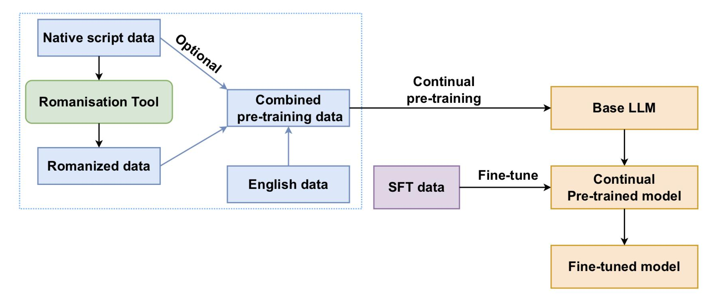
Design
Notes:
SKIP

Slide 7
Design
Data preprocessing (Romanization)
Continual pre-training
Supervised fine-tuning
Notes:
The authors propose the following design with three main sections
Data preprocessing
Continual Pre-training
Supervised fine-tuning

Slide 8
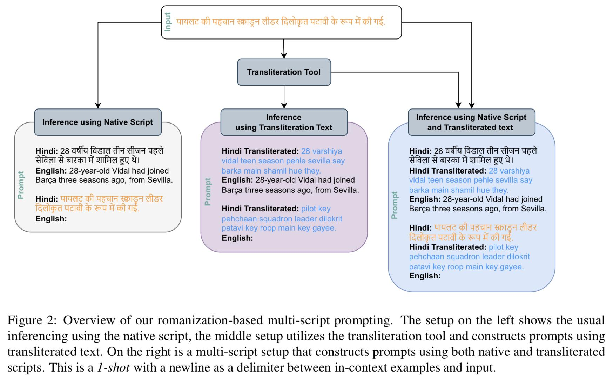
Data preprocessing (Romanization)
Notes:
They prepare the data in different forms
Hindi
Transliterated (Roman Hindi)
Hindi + Transliterated (Roman Hindi)

Slide 9
Design
Data preprocessing (Romanization)
Continual pre-training
Supervised fine-tuning

Slide 10
Continual pre-training
Base model selection Llama 2 7B due to resource constraints
Original Llama 2 tokenizer embedding is used
CPT involves pretraining the base LLM with romanized document-level data
An equal amount of English data is incorporated to prevent forgetting of English capabilities in base model
Next steps: Fine tune in specific tasks
Notes:
For the all the tasks. They use Llama2 which is mostly trained on english data from the internet.
The main objective of of CPT is to familiarize the Base model with hindi and romanized hindi script without forgetting its english capabilities.
Thus, they use the same amount of hindi + english data

Slide 11
Design
Data preprocessing (Romanization)
Continual pre-training
Supervised fine-tuning

Slide 12
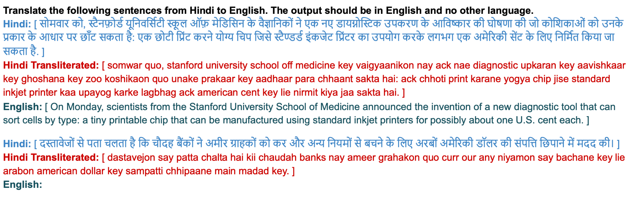
Supervised fine-tuning
Task specific training
Machine Translation
Sentiment Analysis
Notes:
During the supervised fine tuning phase the model is trained to perform specific tasks.
We explored 4 variants of SFT models, depending on
the script configuration of the Hindi SFT data: (a)
romanized examples, (b) native script examples, (c)
multi-script examples, (d) aggregating examples of all three types
In this example the LLM is taking a hindi text and it’s transliterated text as an input to get target english translation.

Slide 13
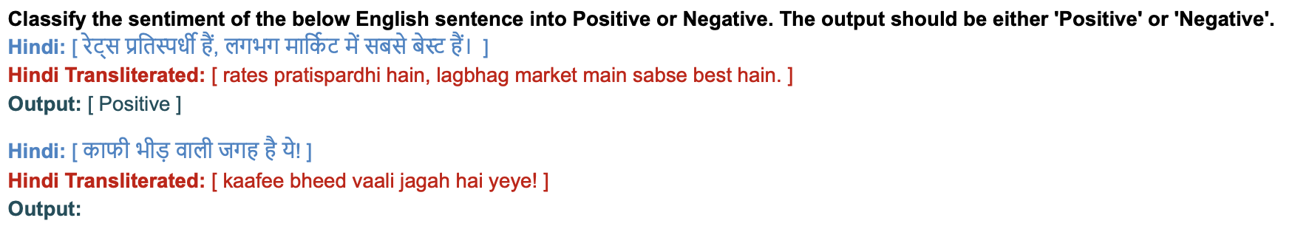
Supervised fine-tuning
Task specific training
Machine Translation
Sentiment Analysis
Notes:
Here we can see that the task is sentimental analisis and the input is the same and the target now is positive or negative sentiment.

Slide 14
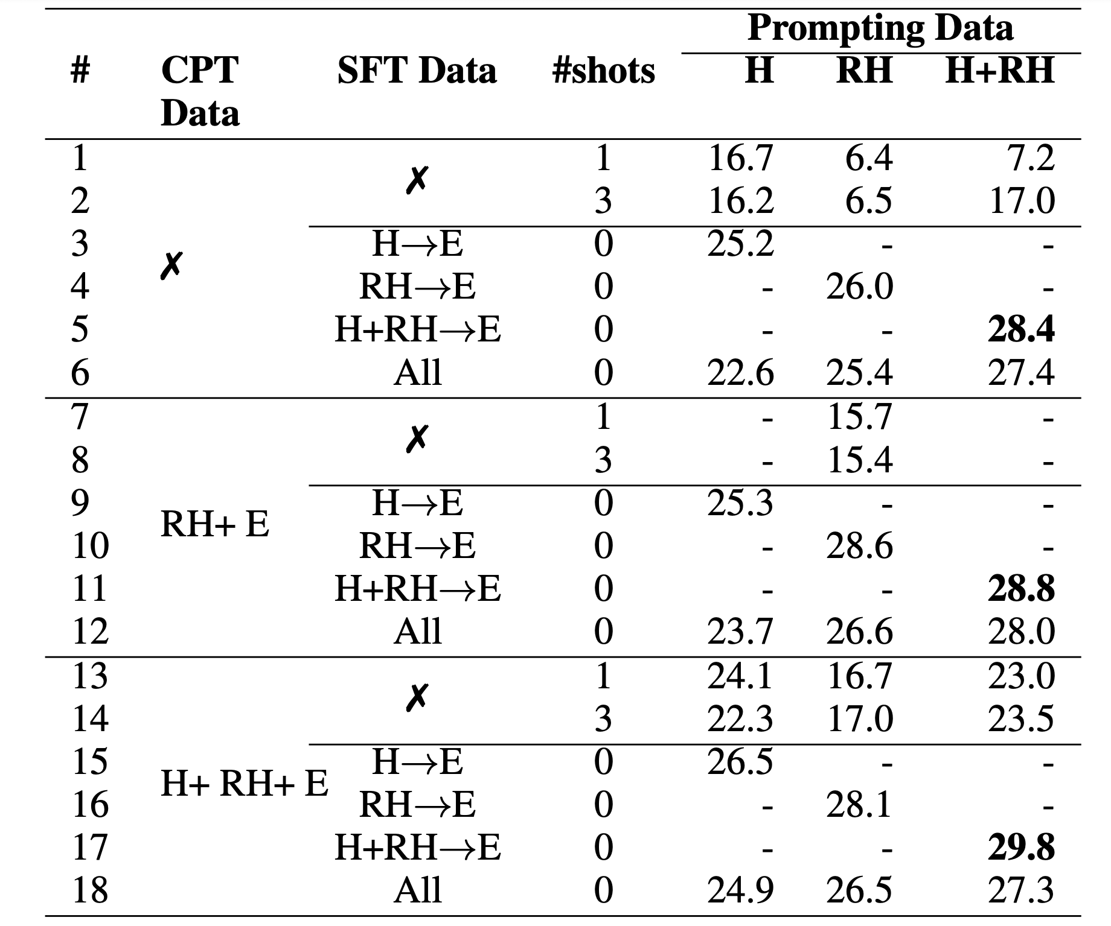
Results: Translation task
The evaluation metric used was the BLEU scores of the output.
The highest BLEU scores were consistently achieved when prompting with the multi-script input of Hindi and Romanized Hindi.
The overall highest BLEU score was achieved when the LLM was continually pretrained with the with the multi-script dataset.
Notes:
Let’s take a look at the results
For the translation the evaluation metric used was BLEU scores of the output
Notably, overall highest BLEU score was achieved when the LLM was continually pretrained and fine-tuned with the multi-script dataset (Hindi+RH).

Slide 15
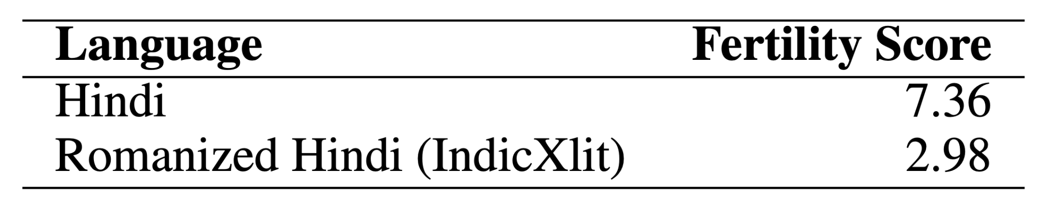
Results: Efficiency Gains with Romanized Prompting
Romanized prompting resulted in an improvement in the efficiency of the LLM model.
The fertility of the romanized text is 2x times lower than the native text
The sequence length for native script text is nearly twice that of the romanized text
Processing romanized text is significantly more efficient than native text at the time of inference

Slide 16
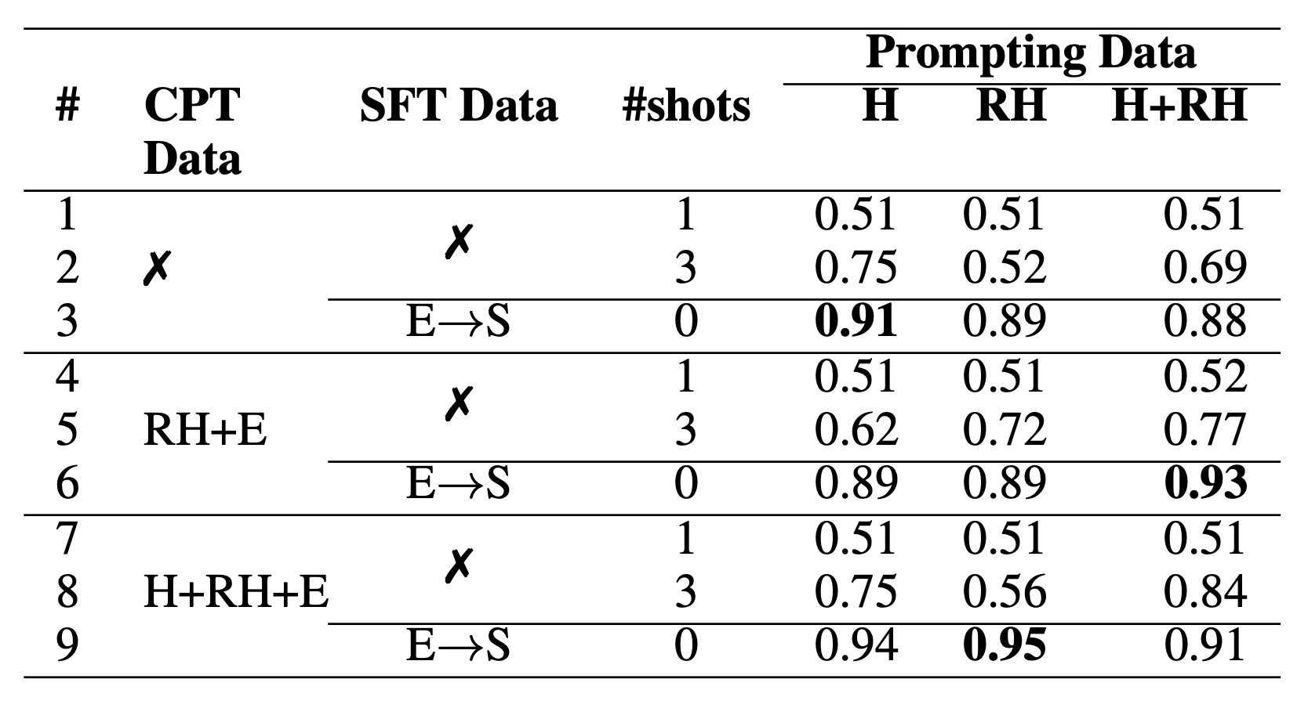
Results: Sentiment Analysis
The table contains accuracies for sentiment analysis of Hindi (H) data to get sentiments (S)
Once again, the highest accuracy was achieved when the LLM was continually pretrained with the multi-script (H+RH+E) dataset.

Slide 17
Conclusion | Future Work
Authors propose romanization of non-English, non-Latin script languages for LLMs.
Romanization enhances performance of LLMs trained on English.
Experiments include few-shot prompting, supervised fine-tuning on tasks like machine translation.
Results indicate significant improvement in efficiency of inferences for these languages.
Expand experiments to include more languages and diverse NLP tasks, especially generation tasks.
Focus on training models with larger text corpora spanning multiple languages.
Emphasize cross-lingual transfer and cross-task transfer to broaden the impact of the research.
Notes:
To conclude we have significant improvement in efficiency of inferences for these languages.
The future work includes more languages to diverse NLP tasks, Larger text corpora, and cross lingual transfer to broaden impact of research.
Thank you.

